Slide 1
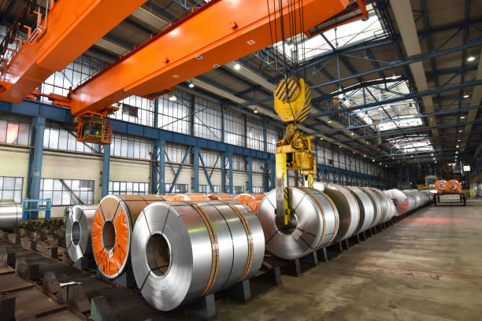


OPTIMIZATION OF STEEL MANUFACTURING

Slide 2
Contents
Business Objective
Business Constraints
Project Architecture - Data Flow Diagram
Data Collection
Exploratory Data Analysis
Data Visualization
Notes:
Change

Slide 3
Business Problems
The company faces challenges with inconsistent material mix and power consumption, leading to issues with product quality.
Finding the optimal combination of materials and power usage will help improve efficiency, reduce costs, and maintain consistent product quality.

Slide 4
Project Overview and Scope
The Optimization of Steel Manufacturing project focuses on improving the efficiency, quality, and cost-effectiveness of steel production processes. By analyzing and optimizing various aspects of the manufacturing process—such as raw material usage, energy consumption, process timing, temperature control, and equipment performance—the project aims to enhance overall production outcomes while reducing waste and costs.
Scope:
The scope of the project includes:
Material Optimization: Efficient use of raw materials like coke, scrap, and iron to reduce costs and improve sustainability.
Energy Management: Reducing energy consumption while maintaining high production quality.
Process Efficiency: Streamlining production times, minimizing downtime, and optimizing cycle times to increase output.
Quality Control: Ensuring consistent chemical composition and product quality.
Equipment Maintenance: Monitoring and optimizing equipment performance to reduce breakdowns and prolong machinery lifespan.
Waste Reduction: Minimizing waste and improving recycling processes to enhance environmental sustainability.

Slide 5
Data Dictionary
Column Name | Description | Data Type
SRNO | Serial number | Nominal
DATETIME | Date and time of the data recorded | Interval
HEATNO | Unique identifier for the heat | Nominal
GRADE | Grade of steel being processed | Nominal
SECTION_IC | Section's intermediate control status | Nominal
"SI_EAF | Shift incharge Name | Nominal
COKE_REQ | Coke required amount | Ratio
"INJ1_QTY | Coke Injection Qty 1 | Ratio
"INJ2_QTY | Coke Injection Qty 2 | Ratio
BSM | Blast furnace slag modifier | Ratio
TP | Total phosphorus content | Ratio
MSTB | Metal slag through balance | Ratio
SKULL | Skull formation indicator | Ratio
SHRAD | Shredder content | Ratio
REMET | Remet content | Ratio
BP | Blast furnace power | Ratio
HBI | Hot briquetted iron | Ratio
OTHERS | Other materials quantity | Ratio
SCRAP_QTY (MT) | Scrap Steel (%) | Ratio
PIGIRON | Pig iron quantity | Ratio
DRI1_QTY (MT) (Lumps) | DRI (Direct Reduced Iron) Lumps quantity | Ratio
"DRI2_QTY | DRI (Direct Reduced Iron) Fines quantity | Ratio
TOT_DRI_QTY | Total DRI quantity | Ratio
HOT_METAL (HOT Metal from MBF) | Hot metal from blast furnace | Ratio
Total Charge | Total charge input | Ratio
Hot_Heel (Left Over Liquid metal in EAF) | Leftover liquid metal in EAF | Ratio
DOLO | Dolomite content | Ratio
DOLO1_EMPTY | Dolomite 1 empty status | Ratio
TOT_LIME_QTY | Total lime quantity | Ratio
TAP_TEMP (Tapping Temperature) | Tapping temperature | Interval
O2REQ | Oxygen required | Ratio
O2ACT | Actual oxygen content | Ratio
ENERGY (Energy Consumption) | Energy consumption | Ratio
KWH_PER_TON (Energy Consumption Per Ton) | Energy consumption per ton | Ratio
KWH_PER_MIN | Energy consumption per minute | Ratio
MELT_TIME (Melting Time) | Melting time in EAF | Ordinal
TA_TIME (Turn Around Time) | Turnaround time | Ordinal
TT_TIME (Total Cycle Time Including Breakdown) | Total cycle time including breakdown | Ordinal
POW_ON_TIME | Power on time | Interval
TAPPING_TIME | Tapping time | Interval
ARCING_TIME | Arcing time | Ordinal

Slide 6
DOWN_TIME | Downtime | Ordinal
E1_CUR (Electrode 1 Current) | Electrode 1 current | Ratio
E2_CUR (Electrode 2 Current) | Electrode 2 current | Ratio
E3_CUR (Electrode 3 Current) | Electrode 3 current | Ratio
SPOUT (Bottom Refractory Temperature) | Bottom refractory temperature (spout) | Interval
DOLOMIT | Dolomite temperature | Ratio
CPC | Calcined petroleum coke | Ratio
TEMPERATURE | Temperature measurement | Interval
POWER | Power measurement | Ratio
LAB_REP_TIME | Laboratory reporting time | Interval
C | Carbon (%) | Ratio
SI | Silicon (%) | Ratio
MN | Manganese (%) | Ratio
P | Phosphorus (%) | Ratio
S | Sulfur (%) | Ratio
CU | Copper (%) | Ratio
CR | Chromium (%) | Ratio
NI | Nickel (%) | Ratio
N | Nitrogen (%) | Ratio
TIME_UTLN_PRCNT | Time utilization percentage | Ordinal
TOP_COKE | Top coke usage | Ratio
OPEN_C | Open coke usage | Nominal
TAP_C | Tapping coke usage | Nominal
IT_KG | Iron tapping weight | Ratio
BUCKET_NO | Bucket number identifier | Nominal
STATIC_WT | Static weight measurement | Ordinal
LIME | Lime quantity | Ratio
LIME2 | Lime 2 quantity | Ratio
O2SIDE1 | Oxygen side measurement 1 | Nominal
O2SIDE2 | Oxygen side measurement 2 | Nominal
O2SIDE3 | Oxygen side measurement 3 | Nominal
SPINNING | Spinning indicator | Nominal
RAMMING1 | Ramming 1 indicator | Nominal
RAMMING2 | Ramming 2 indicator | Nominal
PREV_TAP_TIME | Previous tapping time | Interval
TAP_DURATION | Tapping duration | Ordinal
Pour_Back_Metal | Pour back metal quantity | Nominal
LM_WT | Liquid metal weight | Ratio
Production (MT) | Production volume in metric tons | Ratio

Slide 7

Exploratory Data Analysis [EDA]
Statistical Insights
Business Insights
Mean, Median, Mode: Calculate these for quantitative columns like 'COKE_REQ', 'INJ1_QTY', 'TAP_TEMP', etc.
Standard Deviation and Variance: For understanding dispersion.
Min, Max, Range: To assess the spread of values.
Distribution Analysis:
Histograms: To visualize the distribution of continuous variables.
Box Plots: To identify outliers and understand data spread.
Correlation Analysis:
Correlation Matrix: To find relationships between variables, such as between 'ENERGY' and 'KWH_PER_TON'.
Trend Analysis:
Time Series Analysis: For columns like 'DATETIME' to see trends over time.
Seasonal Effects: If applicable, identify any seasonal patterns.
Comparative Analysis:
Comparisons Between Groups: For categorical data, compare different sections or heat numbers.
Anomalies Detection:
Outlier Detection: Identify any unusual values or patterns that deviate significantly from the norm.
Energy Efficiency: Implement energy-saving technologies and monitor energy consumption per ton of steel to reduce costs and environmental impact.
Material Utilization: Optimize the use of raw materials like scrap, pig iron, and direct reduced iron (DRI) to minimize waste and lower material costs.
Process Optimization: Reduce downtime and cycle times by improving furnace operations, such as controlling melt time, tapping time, and turnaround time.
Quality Assurance: Maintain consistent product quality by precisely controlling the chemical composition of the steel and adjusting process parameters as needed.
Automation and Data Analytics: Leverage automation and advanced data analytics to predict maintenance needs, optimize production schedules, and enhance overall operational efficiency.
Notes:
EDA is used for seeing what the data can tell us before the modeling task.
Change

Slide 8
Data Preprocessing
1. Data Loading and Initial Inspection:
Read the Data: The dataset is loaded from an Excel file into a Pandas DataFrame using pd.read_excel.
Shape of Data: The shape of the dataset (number of rows and columns) is displayed using da.shape.
Data Information: The da.info() function provides an overview of the dataset, including data types and non-null counts for each column.
Column Names: The column names of the dataset are printed using da.columns.
2. Descriptive Statistics on columns:
Central Tendency & Dispersion:
Mean, Median, Mode: The mean, median, and mode are calculated to understand the central tendency.
Standard Deviation & Variance: The standard deviation (std) and variance (var) are calculated to understand the spread of the data.
Range: The range (difference between max and min values) is computed.
Skewness & Kurtosis: These are calculated to understand the shape of the distribution. Skewness measures asymmetry, while kurtosis measures the Peakedness.
3. Graphical Representation:
Histogram: A histogram plotted to visualize its distribution.
Boxplot: A boxplot is created to visualize the presence of outliers.
4. Handling Duplicates:
Duplicate Check: The code checks for duplicate rows using da.duplicated().
Duplicate Count: The number of duplicates is counted with sum(dup).
5. Outlier Detection and Handling:
IQR Calculation: The Interquartile Range (IQR) is calculated to identify outliers.
Lower & Upper Limits: The lower and upper bounds for outliers are determined using 1.5 * IQR rule.
Outlier Replacement: Outliers are replaced with the respective lower or upper limit values using np.where.
6. Zero and Near-Zero Variance Detection:
Variance Calculation: The variance of each column is calculated.
Near-Zero Variance Features: Columns with variance less than 0.01 are identified, as these may not contribute meaningfully to analysis or modeling.
7. Normalization:
Min-Max Scaling: The column is normalized to a range of [0, 1] using Min-Max Scaling via MinMaxScaler from sklearn.
8. Transformation:
Log Transformation: A logarithmic transformation is applied to normalize its distribution and reduce skewness.
Notes:
Keep observations

Slide 9
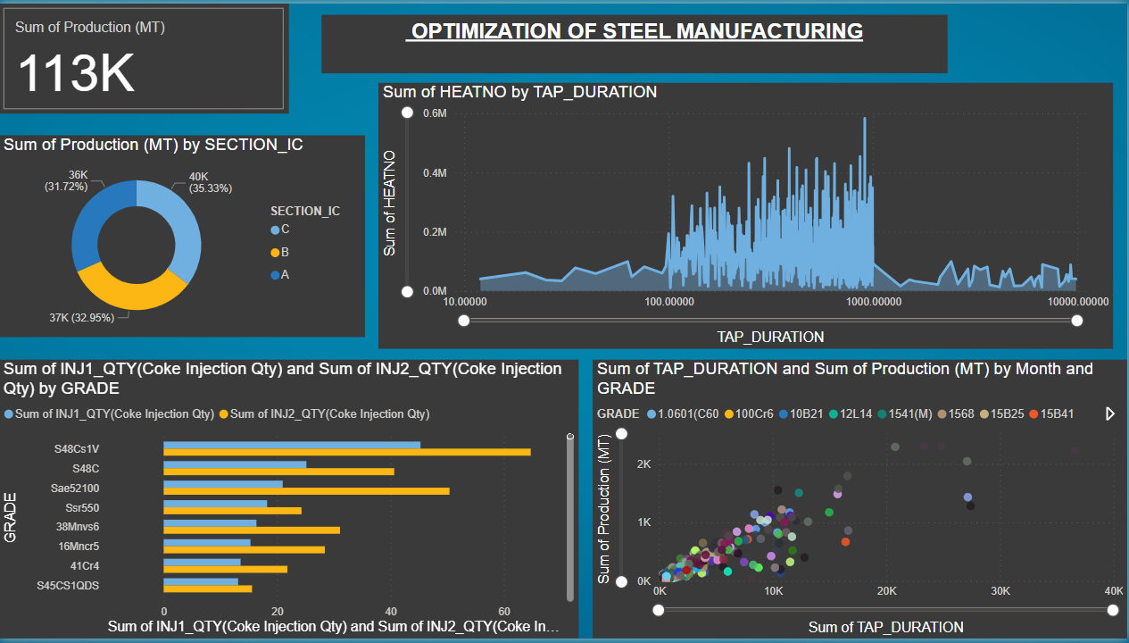
Data Visualization
DATA VISUALIZATION
Notes:
Add graphical

Slide 10
Summary Cards (Top Row):
Distinct Grade: Displays the count of unique grades (305).
Sum of HOT_METAL: Total amount of hot metal (113K).
Sum of SCRAP_QTY: Total quantity of scrap (22K).
AVG_TAP_TEMP: Average tap temperature (5.52K).
SCRAP_QTY vs. Production: A goal-oriented line chart showing scrap quantity compared to production.
Line Chart (Bottom Left, Top Left):
Sum of Production and MELT_TIME: Displays the sum of production (MT) and melting time by year, quarter, and month. It tracks changes over time, with each point representing a month (Aug 2023 to Oct 2023).
Sum of MELT_TIME by Month: Tracks melting time specifically, highlighting changes between August, September, and October.
Scatter Plot (Top Center):
Sum of Production vs. ENERGY by GRADE: A scatter plot visualizing the relationship between production volume and energy consumption across different grades.
Bar Chart (Top Right):
Sum of ENERGY by GRADE: Bar chart showing energy consumption by different grades, with a clear emphasis on the highest consumers.
Pie Chart (Bottom Center):
Count of GRADE by SECTION_IC: A pie chart representing the distribution of different grades across sections (A, B, C), with percentage labels.
Bar Chart (Bottom Right):
Sum of TOT_DRI_QTY by GRADE: Shows the total direct reduced iron quantity by grade, with a focus on the grades with the highest totals.

Slide 11

Notes:
Vmmv

